Slide 1
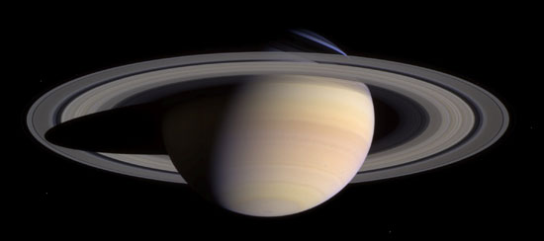
Kronoseismology:
Using Saturn’s rings to study the planet’s internal structure

Slide 2
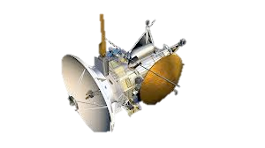
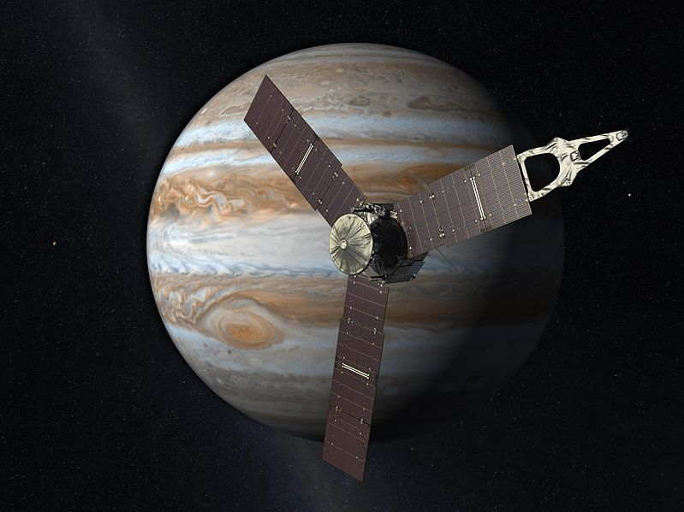
Information from the rings could complement other attempts to understand the internal structures of Jupiter and Saturn
Cassini
Juno

Slide 3
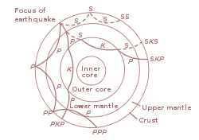
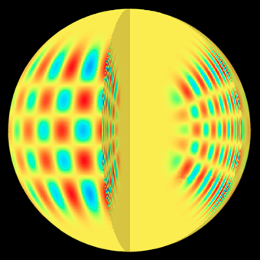
Seismology is a powerful tool for studying interior structures

Slide 4
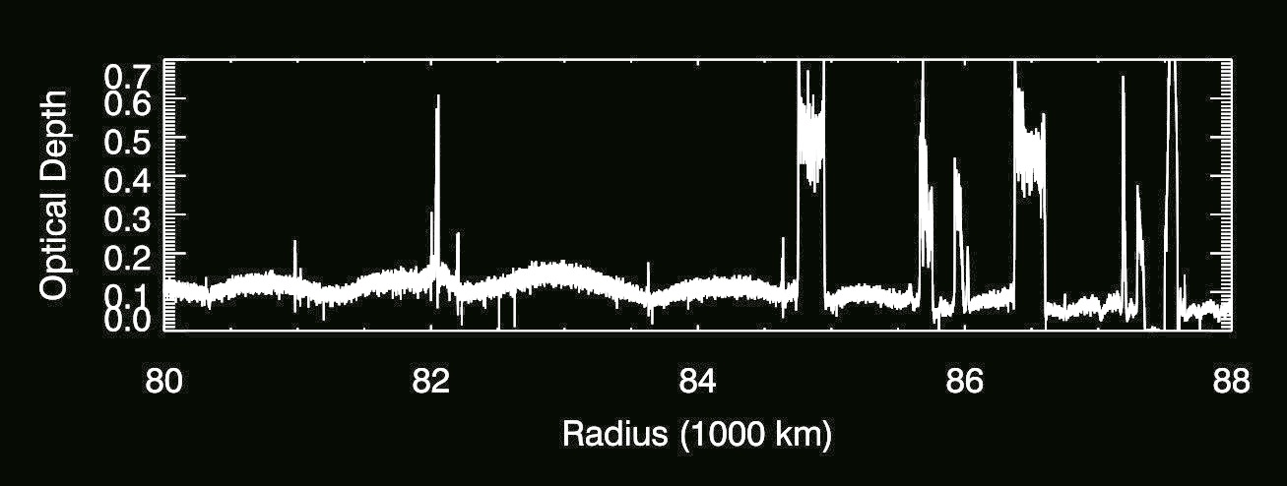
Voyager uncovered spiral patterns in Saturn’s C ring
C
B
A

Slide 5
Similar patterns are found in the A ring, near
mean-motion resonances with Saturn’s moons
C
B
A
Ring Particle Orbital Period= 5/6 Janus’ Orbital Period
Ring Particle Orbital Period= 12/13 Pandora’s Orbital Period
Ring Particle
Orbital Period=
18/19 Prometheus’ Orbital Period

Slide 6
What happens at a resonance.
Moon orbital period of 8 days
Ring particle, orbital period of 4 days
T= -1 days

Slide 7
More distant moons can affect rings too
T= 0 days

Slide 8
More distant moons can affect rings too
T= 1 days

Slide 9
More distant moons can affect rings too
T= 2 days

Slide 10
More distant moons can affect rings too
T= 3 days

Slide 11
More distant moons can affect rings too
T= 4 days

Slide 12
More distant moons can affect rings too
T= 5 days

Slide 13
More distant moons can affect rings too
T= 6 days

Slide 14
T= 7 days

Slide 15
T= 8 days

Slide 16
The non-circular motions of the particles near the resonance are organized
forming a pattern that tracks the moon.
Note that while the edges have more than one lobes, individual particles on the edge are following simple elliptical paths.
The perturbations from the moon synchronize these radial motions to produce the two-lobed patterns.
To Mimas

Slide 17
Note that while the edges have more than one lobes, individual particles on the edge are following simple elliptical paths.
The perturbations from the moon synchronize these radial motions to produce the two-lobed patterns.
To Mimas
The non-circular motions of the particles near the resonance are organized
forming a pattern that tracks the moon.

Slide 18
The non-circular motions of the particles near the resonance are organized
forming a pattern that tracks the moon.
Note that while the edges have more than one lobes, individual particles on the edge are following simple elliptical paths.
The perturbations from the moon synchronize these radial motions to produce the two-lobed patterns.
To Mimas

Slide 19
Note that while the edges have more than one lobes, individual particles on the edge are following simple elliptical paths.
The perturbations from the moon synchronize these radial motions to produce the two-lobed patterns.
To Mimas
The non-circular motions of the particles near the resonance are organized
forming a pattern that tracks the moon.

Slide 20
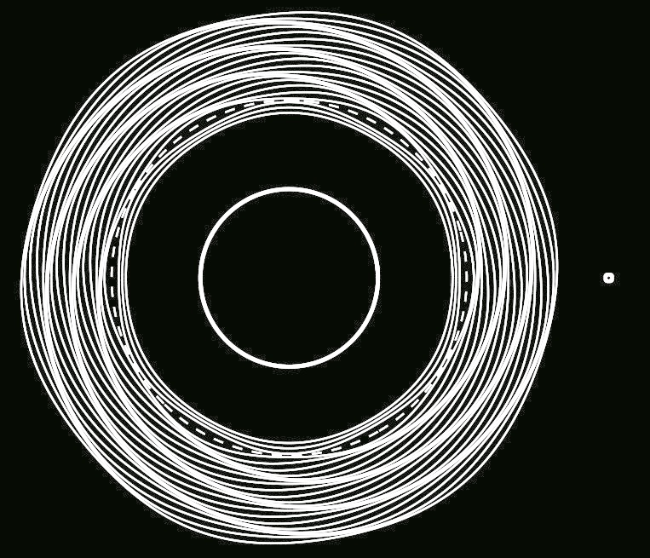
In dense rings, these organized motions drive a propagating spiral wave through the ring
Ring Particle Orbital Period= 5/6 Janus’ Orbital Period
The wave pattern maintains a fixed orientation relative to the moon.

Slide 21
The patterns in the C ring are nowhere near any known satellite resonances.
C
B
A

Slide 22
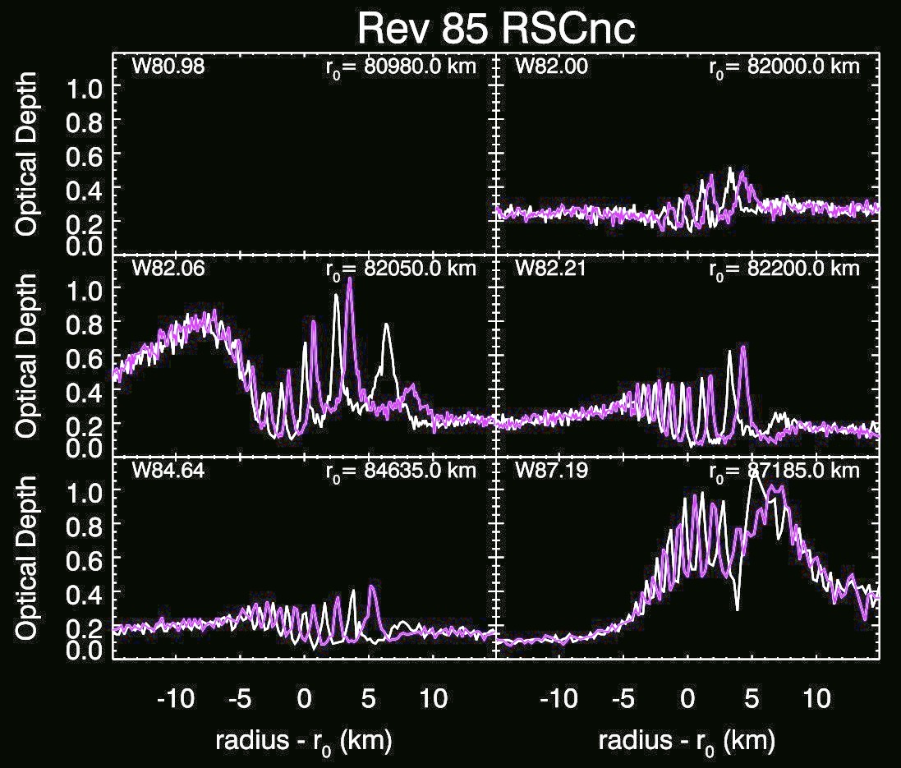
Shifts in the peak locations between observations made at different times and longitudes confirm that these are spiral patterns.

Slide 23
At least some of these waves may be due to
sectoral normal mode oscillations within the planet.
Standing
Retrograde
Prograde
l=m=2
l=m=3
l=m=4
Marley 1991, Marley and Porco 1993

Slide 24
The prograde-propagating oscillations can organize particle motions near resonances much like a moon can
The strongest patterns are found at first-order resonances:
Mode rotation period ≈ m/(m-1) x Ring-particle’s orbit period
Moon orbit period=
1/2 Ring particle orbit period
Mode rotation period=
3/2 Ring particle orbit period

Slide 25
m=2
m=3
m=4
A single moon can generate multiple resonant structures
All the patterns rotate around the planet at the same speed
A planetary oscillation mode generates a single resonant structure
Each pattern rotates around the planet at a different speed.
m=2
m=3
m=4

Slide 26
Previous theoretical calculations had shown that some of the unidentified waves could be close to resonance with these modes
W87.19
W82.06
W82.00
W80.98
W82.21
W84.64
Marley 1991,
Marley and Porco 1993

Slide 27
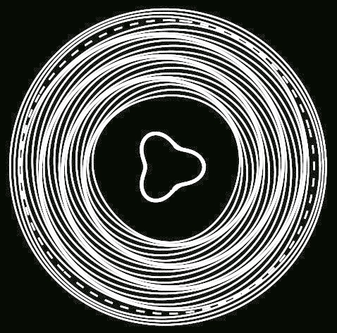
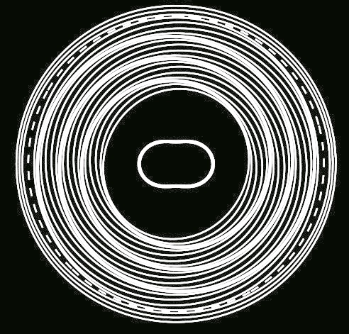
We can determine the m-numbers and pattern speeds of these waves by comparing observations taken at different times and longitudes.
m = 3
m = 2

Slide 28
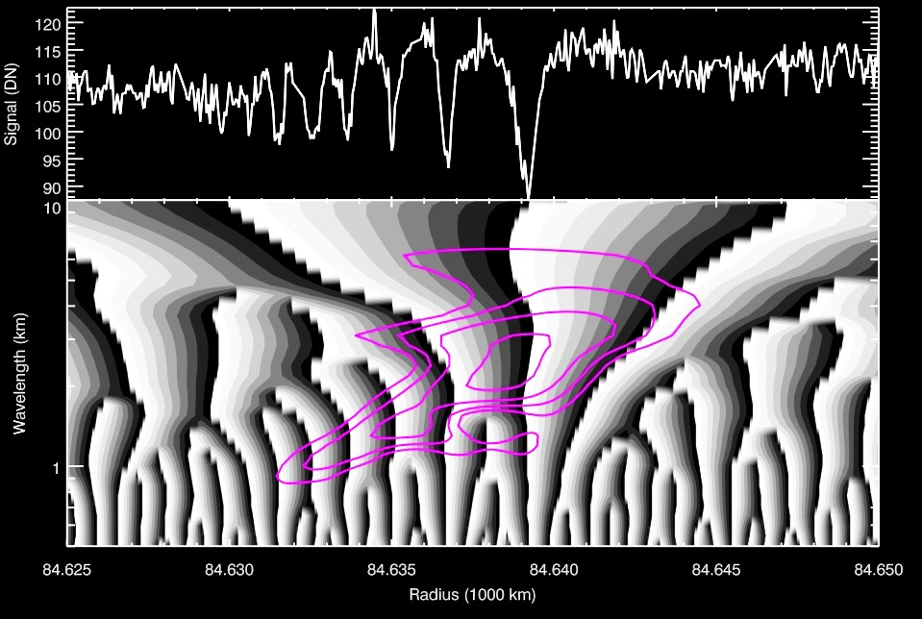

Slide 29
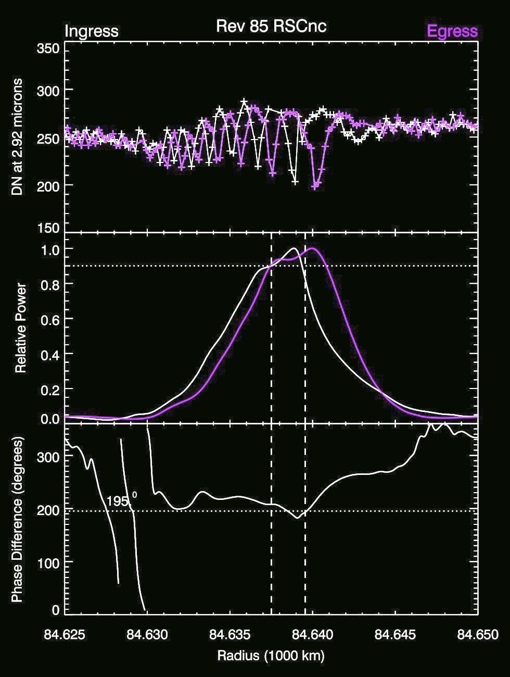
For any pair of occultations, we can compute a
phase difference δϕ
that quantifies how much the peaks and troughs are out of line.

Slide 30
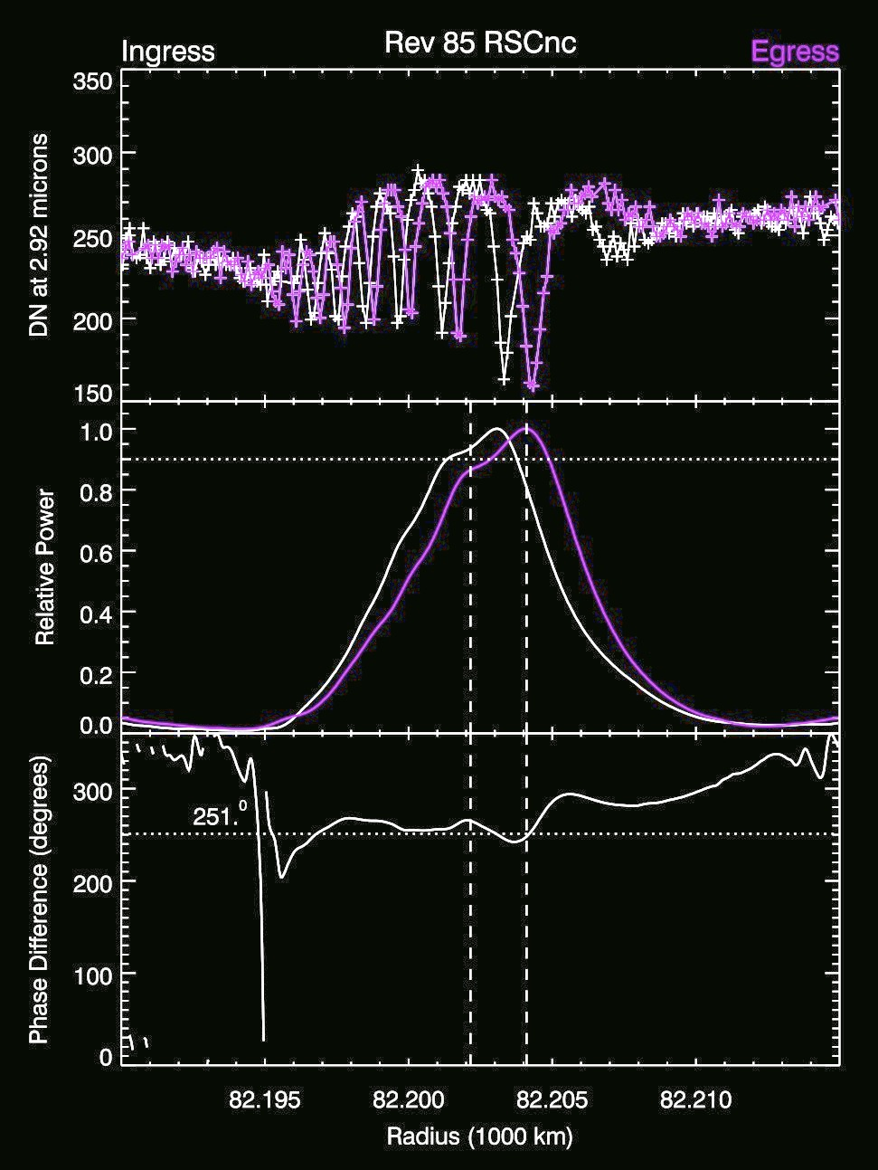
For any pair of occultations, we can compute a
phase difference δϕ
that quantifies how much the peaks and troughs are out of line.

Slide 31
The expected δϕ matches the observed δϕ for the m=3 mode
δϕ ~ 150⁰
δϕ
δϕ ~ 150⁰
m = 2
m = 3

Slide 32
The expected δϕ matches the observed δϕ for the m=3 mode
δϕ ~ 150⁰
δϕ
δϕ ~ 150⁰
δϕ
δϕ ~ -110⁰
δϕ ~ -110⁰

Slide 33
For several waves, the derived mode-number is close to the predicted value,
m=3

Slide 34
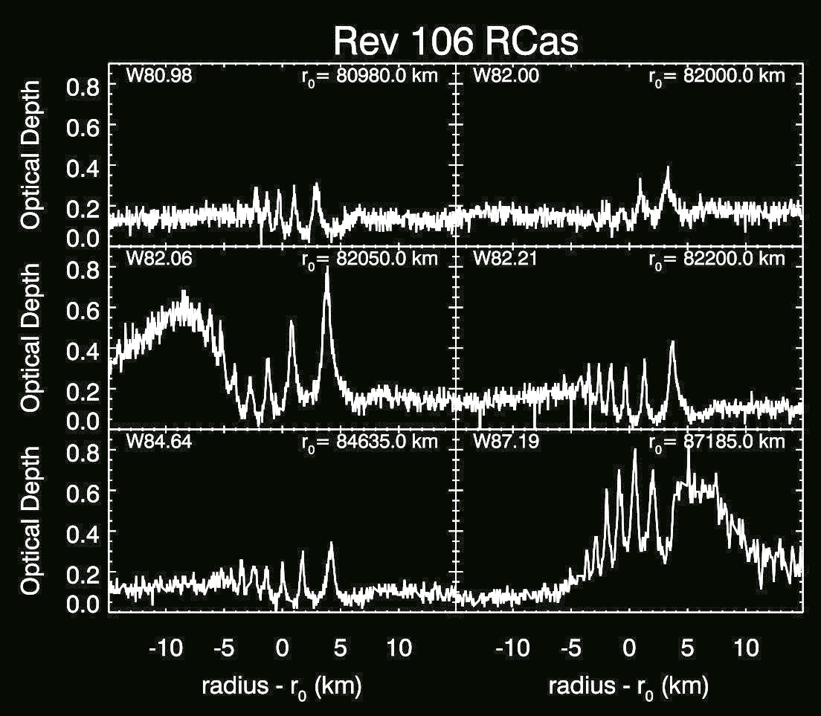

Slide 35
For several waves, the derived mode-number is close to the predicted value,
m=3
m=4

Slide 36
For several waves, the derived mode-number is close to the predicted value,
m=2
m=3
m=4

Slide 37
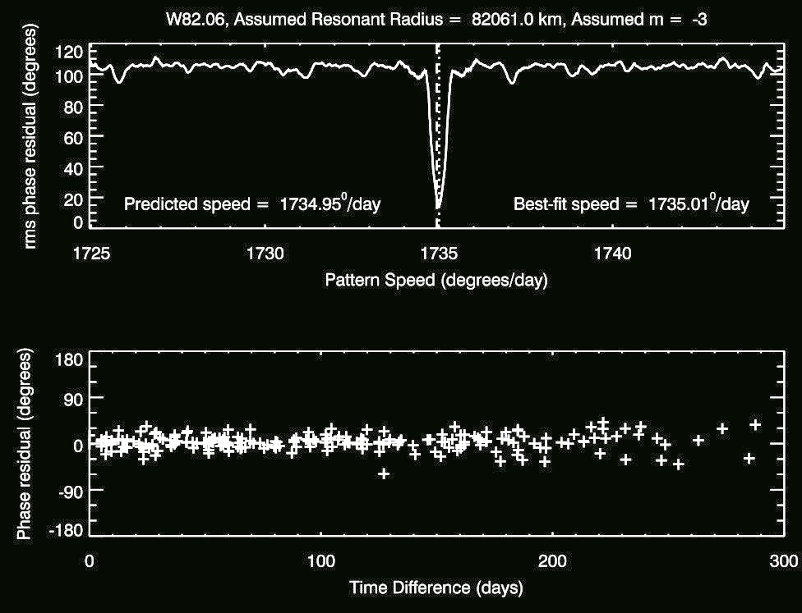

Slide 38
For several waves, the derived mode-number is close to the predicted value, but there appear to be multiple waves generated by resonances with the
m = 2 and m = 3 modes!
m=2
m=3
m=3
m=3
m=4
m=2

Slide 39
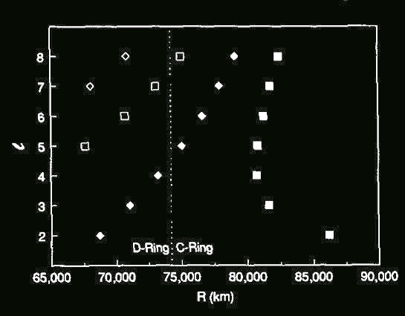
Figure 4 from Marley and Porco 1983
Marley and Porco also predicted additional resonances with m=5,6,7,8 and 9 in this region.
m=2
m=3
m=3
m=3
m=4
m=2

Slide 40
Figure 4 from Marley and Porco 1983
Marley and Porco also predicted additional resonances with m=5,6,7,8 and 9 in this region, but a comprehensive search has only uncovered m=10 thus far
Something is odd about the excitation spectrum of Saturn’s normal modes
m=2
m=3
m=3
m=3
m=4
m=10
m=2

Slide 41
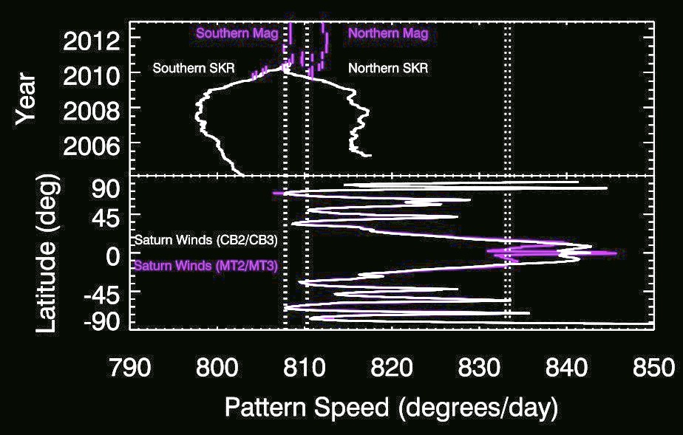
We have also found five waves with pattern speeds between 805⁰/day and 835⁰/day , which are close to Saturn’s rotation rate
m=+3
m=+3
m=2
m=3
m=3
m=3
m=4
m=10
m=2

Slide 42
Finally, we found a very strange, “backwards” wave that appears to be an m=1 wave with a pattern speed equal to twice the local orbital speed
m=+3
m=1
m=+3
m=2
m=3
m=3
m=3
m=4
m=10
m=2

Slide 43
Wave with pattern speed greater than local orbital rate
Outer Lindblad Resonace
Wave with pattern speed greater than local orbital rate?
Wave with pattern speed less than local orbital rate
Inner Lindblad Resonace

Slide 44
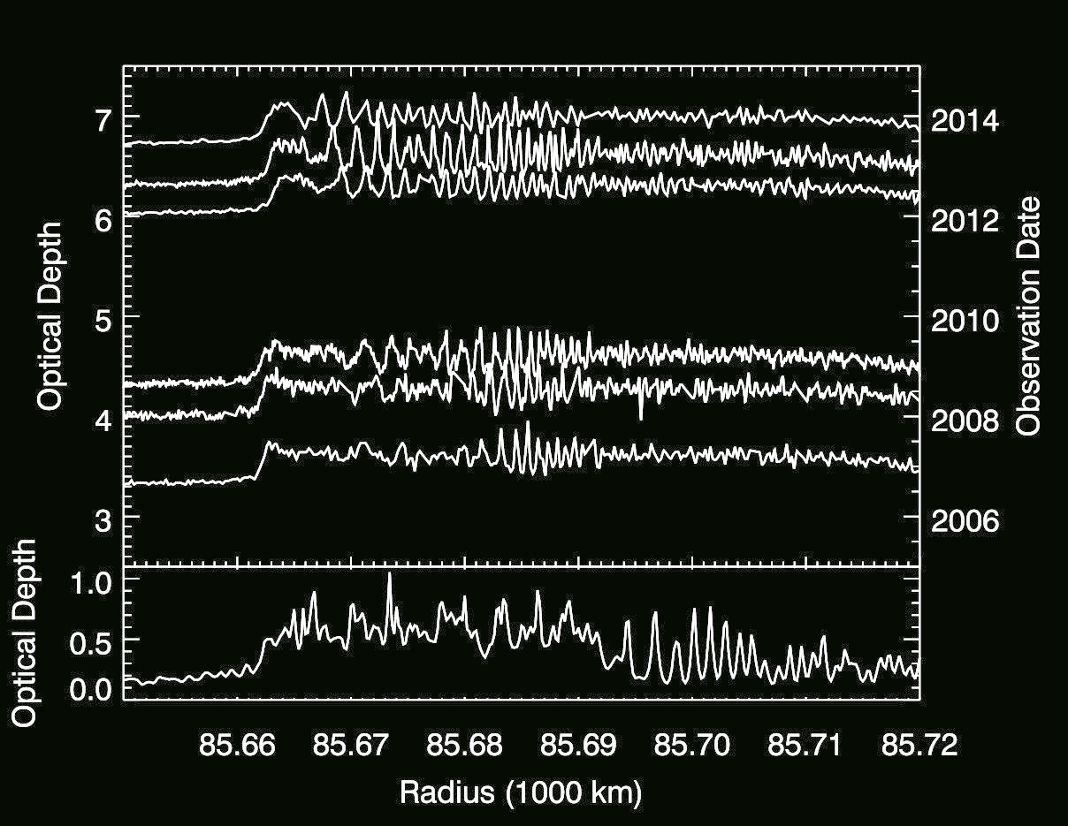
This wave appears to be drifting steadily inwards
at a rate of 0.8 km/year
Cassini
Voyager

Slide 45
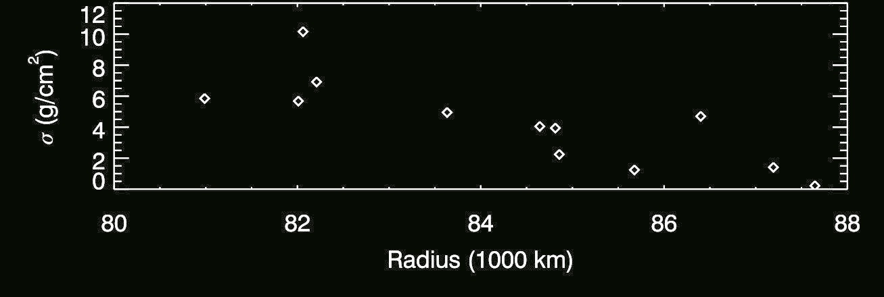
The group velocity of density waves is
v_{g} = πGσ/κ = 0.26 km/year(σ/1g/cm²)
So the resonance is moving faster than the wave!

Slide 46
Normally, the wavelength of the density wave declines as it propagates away from the resonance
v_{g}
v_{g}
time

Slide 47
If the resonance location moves, the wave becomes distorted
v_{res}
v_{g}
v_{g}
time

Slide 48
If the resonance location moves faster than the wave can propagate, the wave can be turned inside out.
v_{res}
v_{g}
v_{g}
time

Slide 49
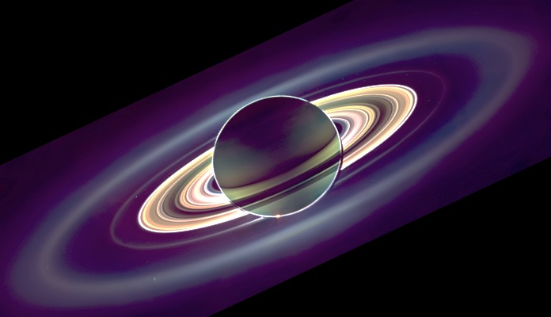
The Dark Side of Saturn and the Rings
Summary:
The C ring data suggests Saturn’s oscillations behave in unexpected ways
Oscillation Modes in Saturn are split
The m=10 mode is strongly excited
Something inside Saturn is changing
Stay Tuned!

Slide 50
Supplemental Material

Slide 51
Spot checks of particular pairs of occultation cuts confirm this result.

Slide 52
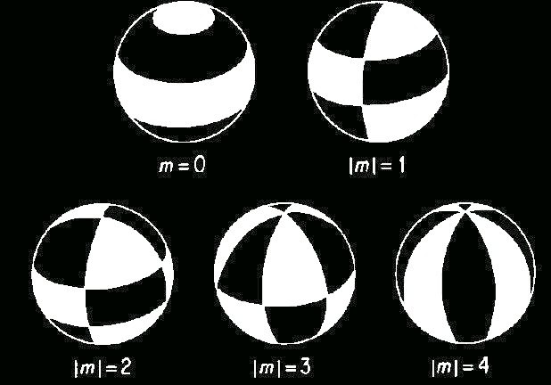

Slide 53
Previous calculations had shown that some of these resonances should lie in the C ring.
Figure 4 from Marley and Porco 1983

Slide 54
Organized motions can be produced by any periodic perturbing force
m – 1
m
Orbit period of ring particle ≈ x Rotation period of perturbing force
Synodic period of the periodic force ≈ m x Epicyclic period of ring particle
not to scale
Frame co-rotating with the moon
Frame co-rotating with the perturbing force

Slide 55
At this resonance, Mimas’ periodic perturbations produce patterns by organizing the radial motions of the ring particles
7
8
Orbit period of ring particle ≈ x Orbital period of moon
Time between ring-moon conjunctions ≈ 8 x Epicyclic period of ring particle
Inertial frame
Frame co-rotating with the moon

Slide 56
What happens at a (first order) Lindblad resonance?
m – 1
m
Orbit period of ring particle ≈ x Orbital period of moon
m x Epicyclic period of ring particle ≈ Period between ring-moon conjunctions
Frame co-rotating with the moon
(assuming m=8)
Inertial frame

Slide 57
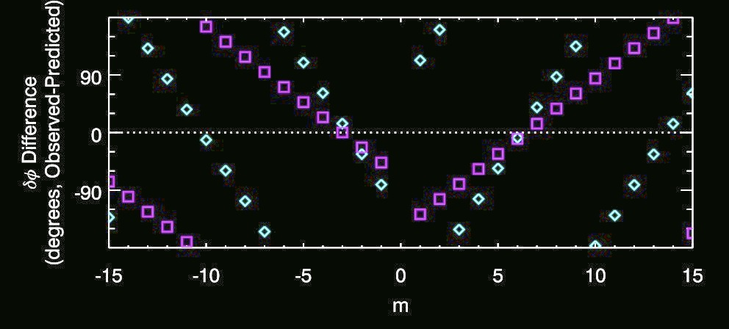
Given the occultation times and longitudes, we can predict what δϕ we should observe if the pattern has a given number of arms, and compare that to the observed value of δϕ
Outer Lindblad Resonances
Inner Lindblad Resonances

Slide 58
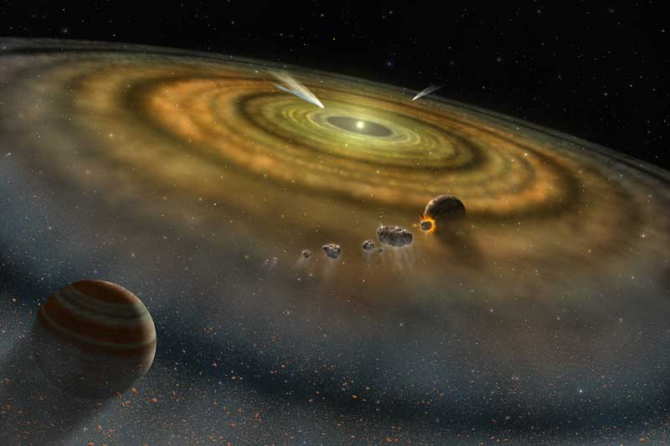
The internal structure of the giant planets can hold clues to how the solar system formed.

Slide 59
What happens at a (first order) Lindblad resonance?
m – 1
m
Orbit period of ring particle ≈ x Orbital period of moon
m x Epicyclic period of ring particle ≈ Period between ring-moon conjunctions
Frame co-rotating with the moon
(assuming m=6)
Inertial frame

Slide 60
The A-ring spiral wave patterns are generated by Lindblad resonances
The strongest patterns are found at first-order resonances:
Moon’s orbit period ≈ m/(m-1) x Ring-particle’s orbit period
Ring Particle Orbital Period= 5/6 Janus’ Orbital Period
In dense rings, the resonant perturbations drive spiral waves through the ring

